Slide 1



HOW TO CREATE BRAND NAME, BRAND EMAIL, BRAND LOGO IN CANVA
TEAM LEADER:
N.ANGALA ESWARI
TEAM MEMBERS:
S.L. AJAY
R.AJIN
S.SREERAM

Slide 2
BRAND NAME:
ANG’S GLOWUP

Slide 3
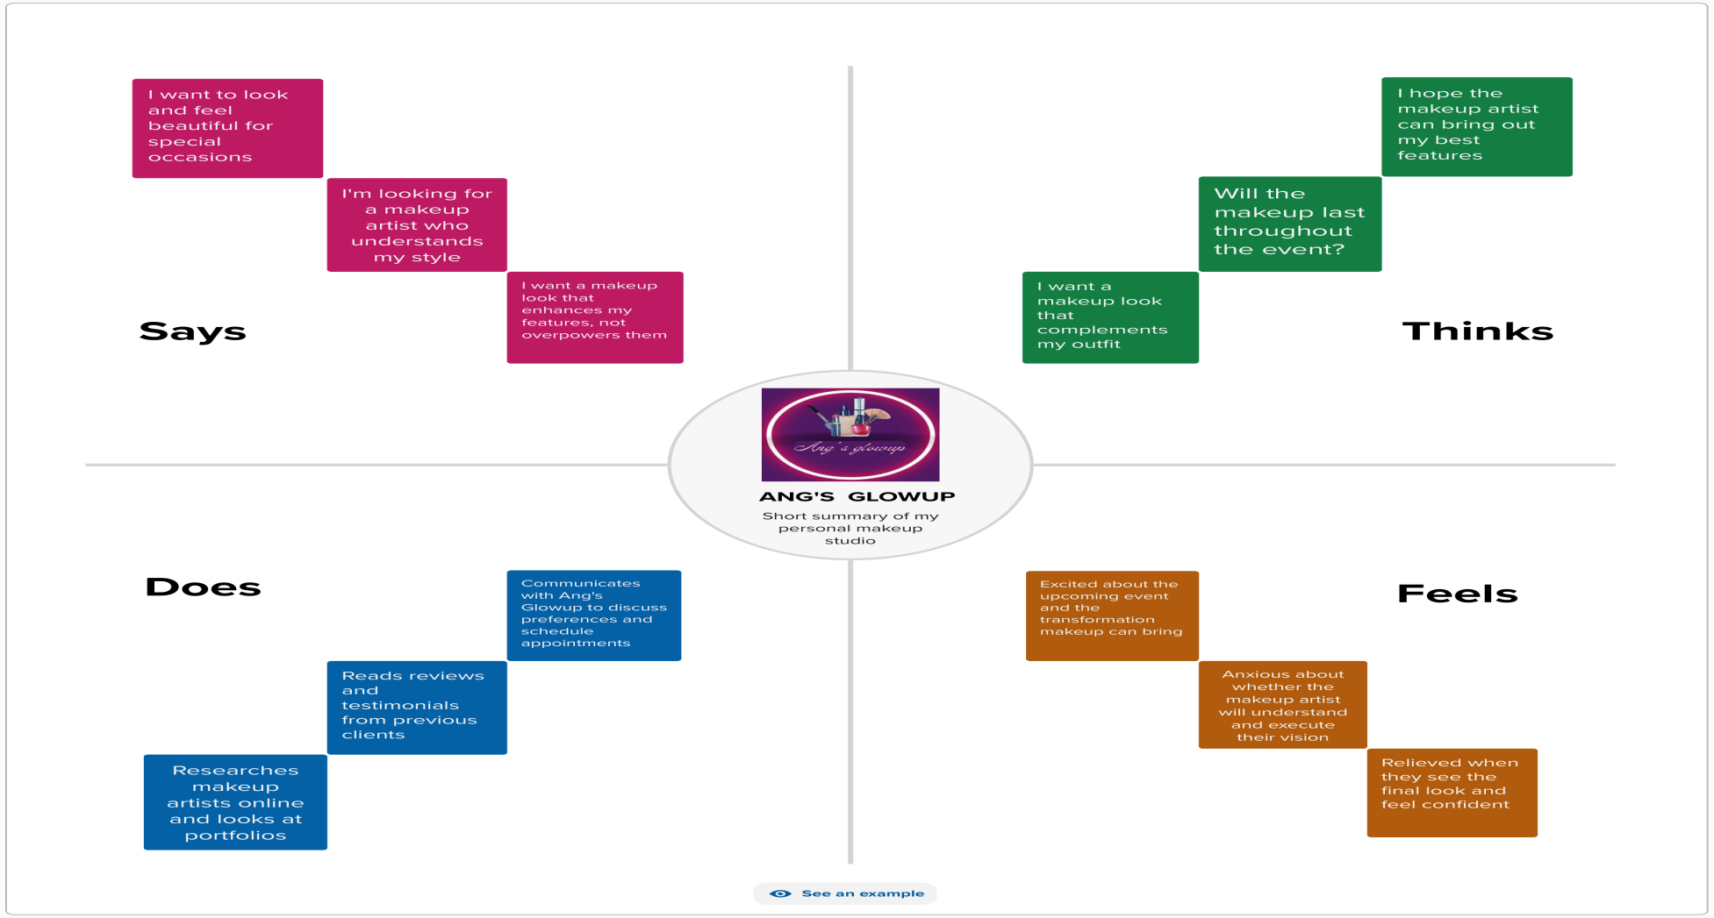
EMPATHY MAP:

Slide 4
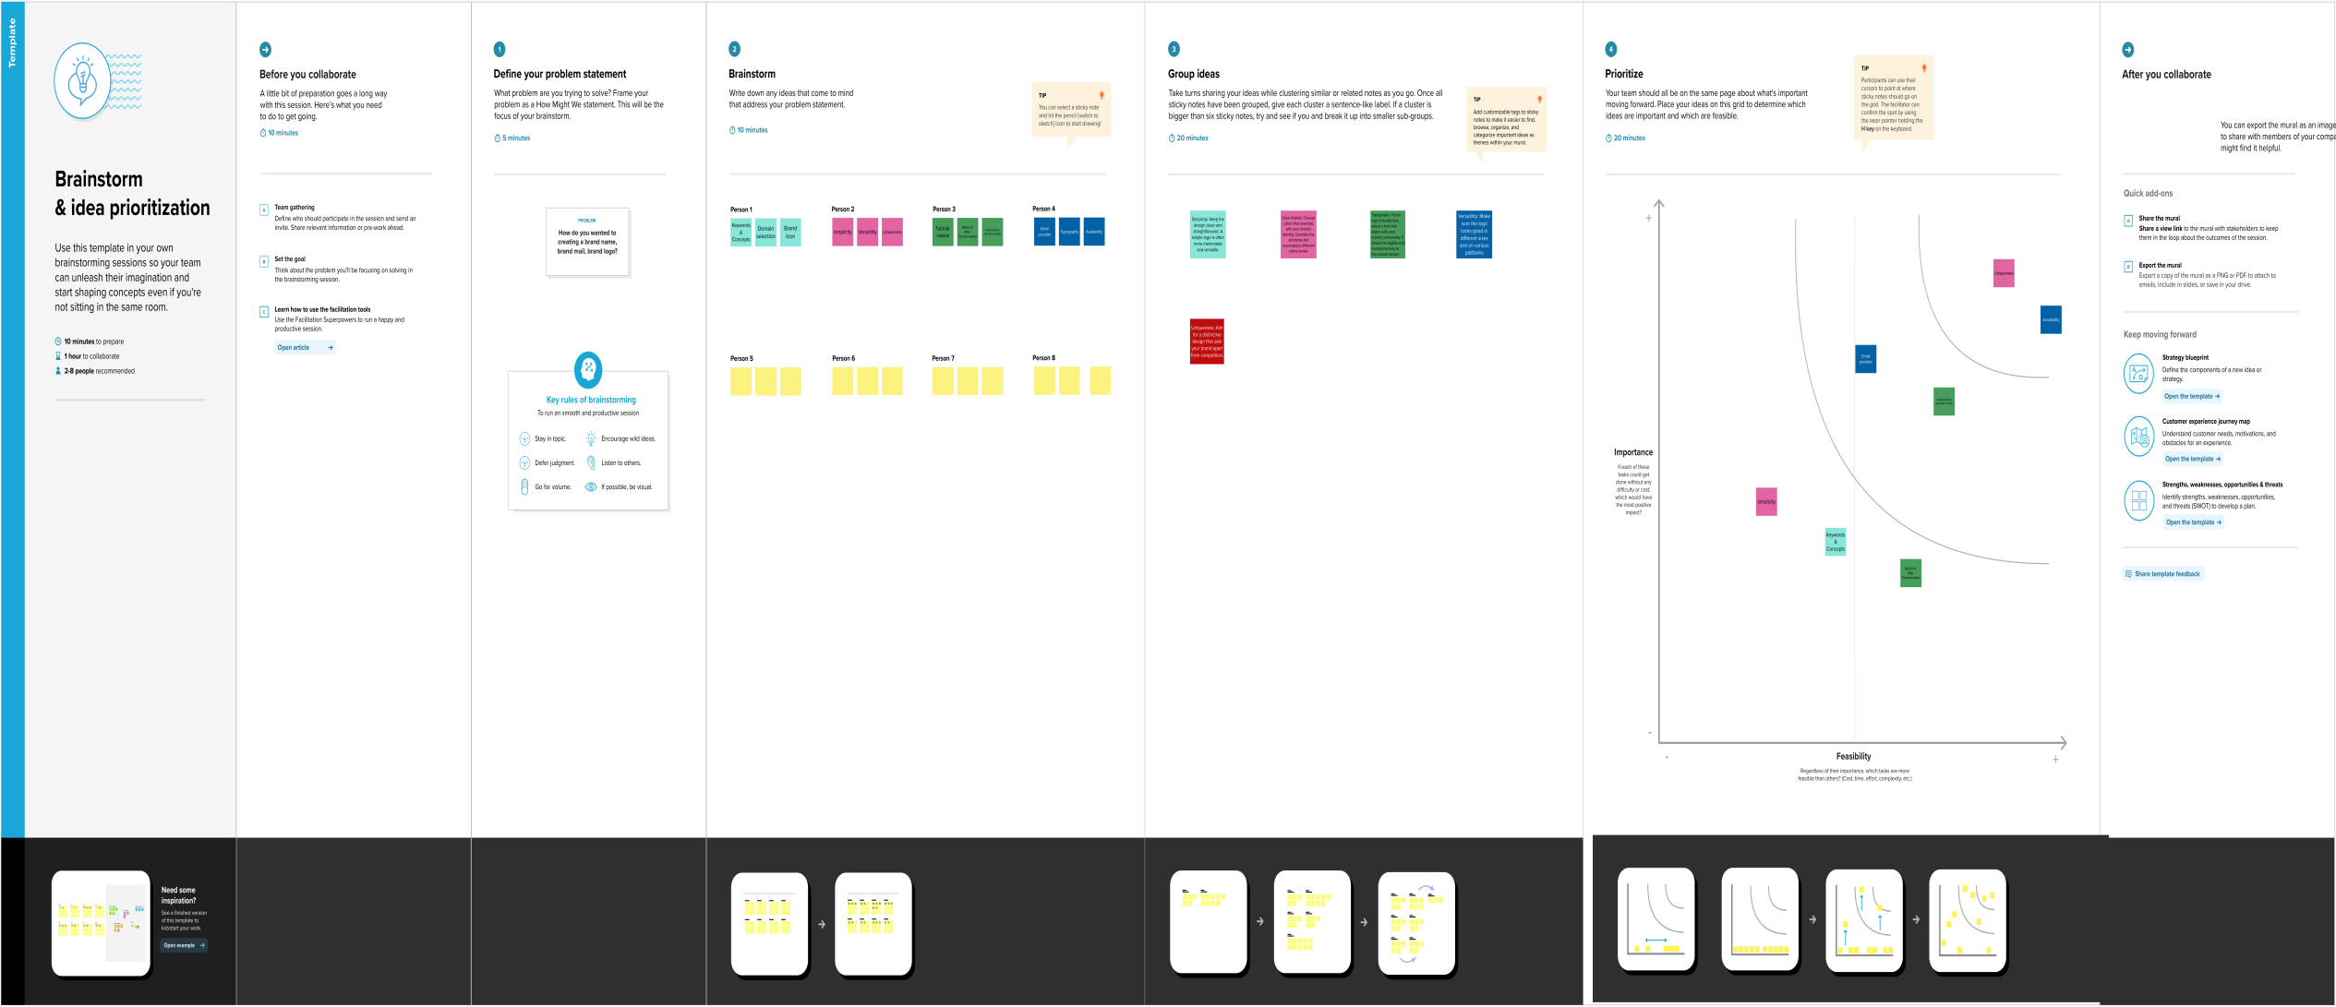
BRAINSTORMING MAP:

Slide 5
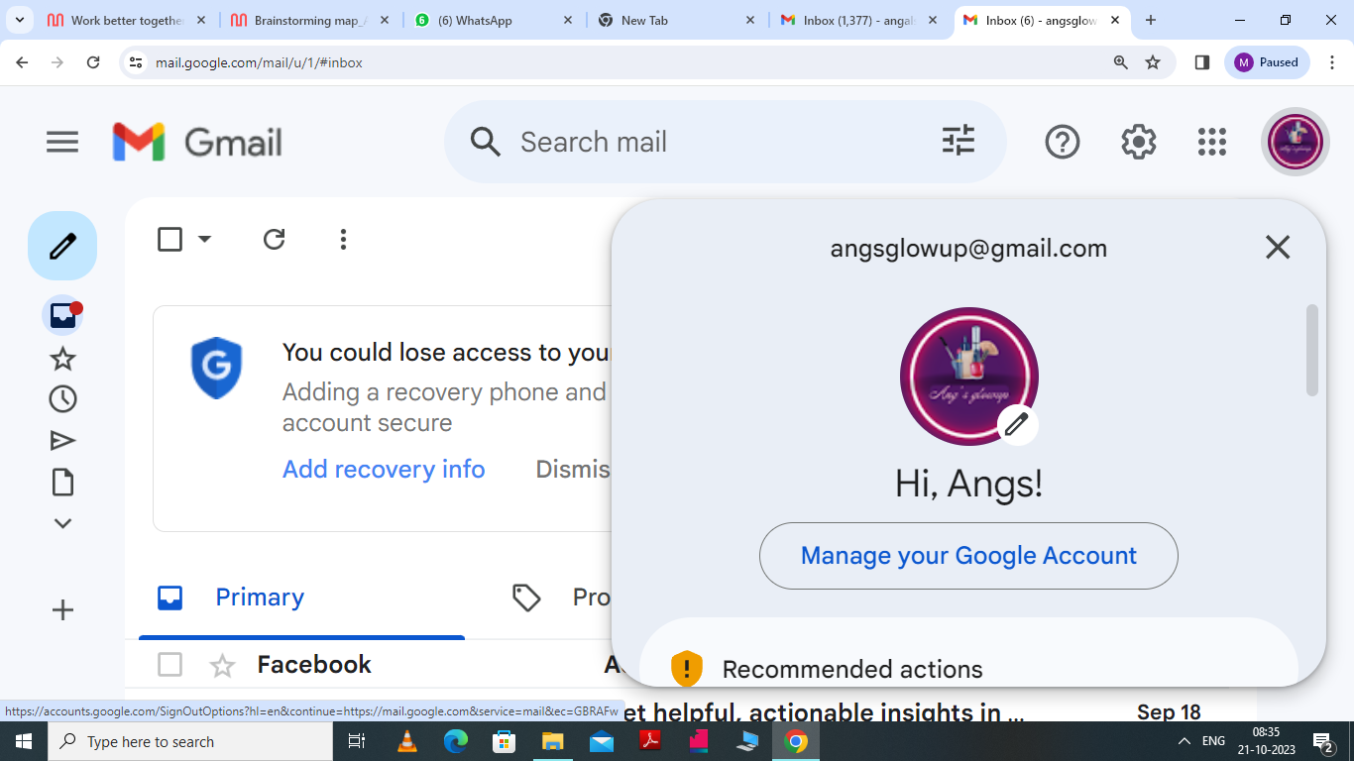
BRAND EMAIL:
angsglowup@gmail.com

Slide 6

BRAND LOGO:

Slide 7


